Slide 1


Empirical Security & Privacy, for Humans
UPenn CIS 7000-010
9/30/2025
Evaluating fuzz testing

Slide 2
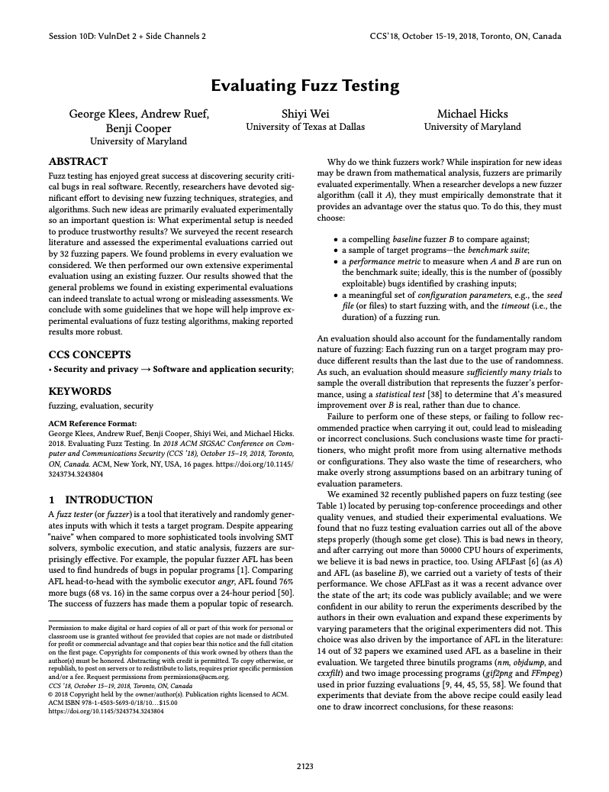
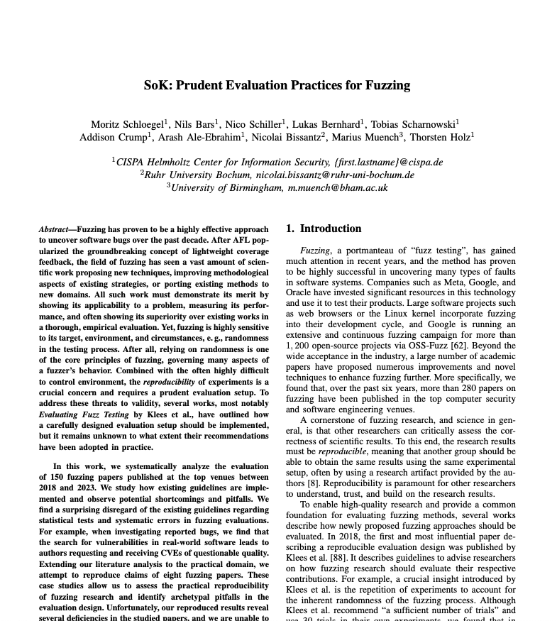
Readings

Slide 3
Readings

Slide 4
Fuzzing
A kind of testing based on random input generation
Goal: make sure certain bad things don’t happen, no matter what
Crashes, thrown exceptions, non-termination
All of these things can be the foundation of security vulnerabilities

Slide 5
Blackbox fuzzing
Initial Seed
RNG
Random bits
Repeatedly mutate an initial seed
Mutator
Mutated
input
Fuzzer
Input
x 1,000,000
Program Under Test
Crash?
Report to User

Slide 6
Coverage-guided fuzzing (e.g., AFL)
Initial Seed
RNG
Random bits
Only mutate seeds that induce new execution paths
Mutator
Mutated
input
Input
Fuzzer
Seed Pool
x 1,000,000
Yes
No
Instrumentation
Program Under Test
New
Paths?
Throw away
Crash?
Report to User
Coverage info

Slide 7
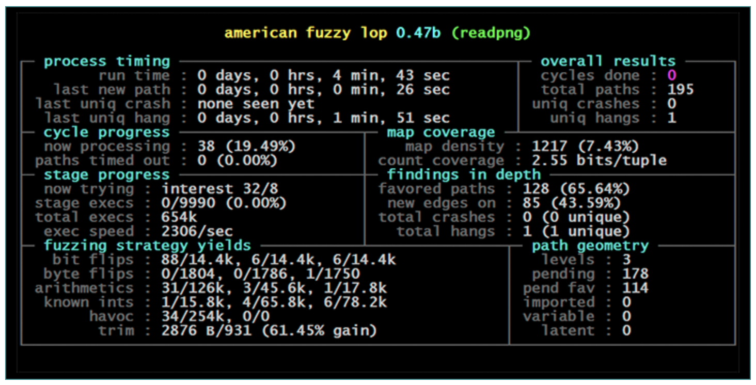

Slide 8
Fuzzing Evaluation Recipe (for new fuzzer A)
A compelling baseline fuzzer B to compare against
A sample of target programs (benchmark suite)
Representative of larger population
A performance metric
Ideally, the number of bugs found (else a proxy)
A meaningful set of configuration parameters
Notably, justifable seed file(s), timeout
A sufficient number of trials to judge performance
Comparison with baseline using a statistical test

Slide 9
Summary of Results
Less than 1/2 of 32 papers we looked at did multiple runs
Fewer still consider variance across runs
And yet fuzzer performance can vary substantially from run to run

Slide 10
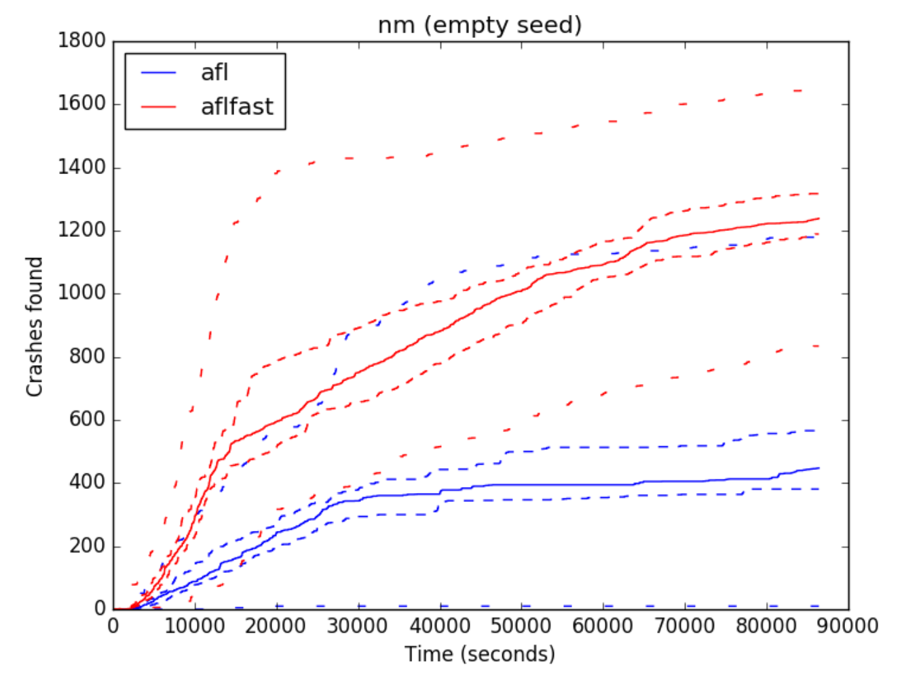
Performance Plot
max
95%
median
95%
min

Slide 11
Performance Plot
max
95%
median
95%
max
min
95%
median
95%
min

Slide 12
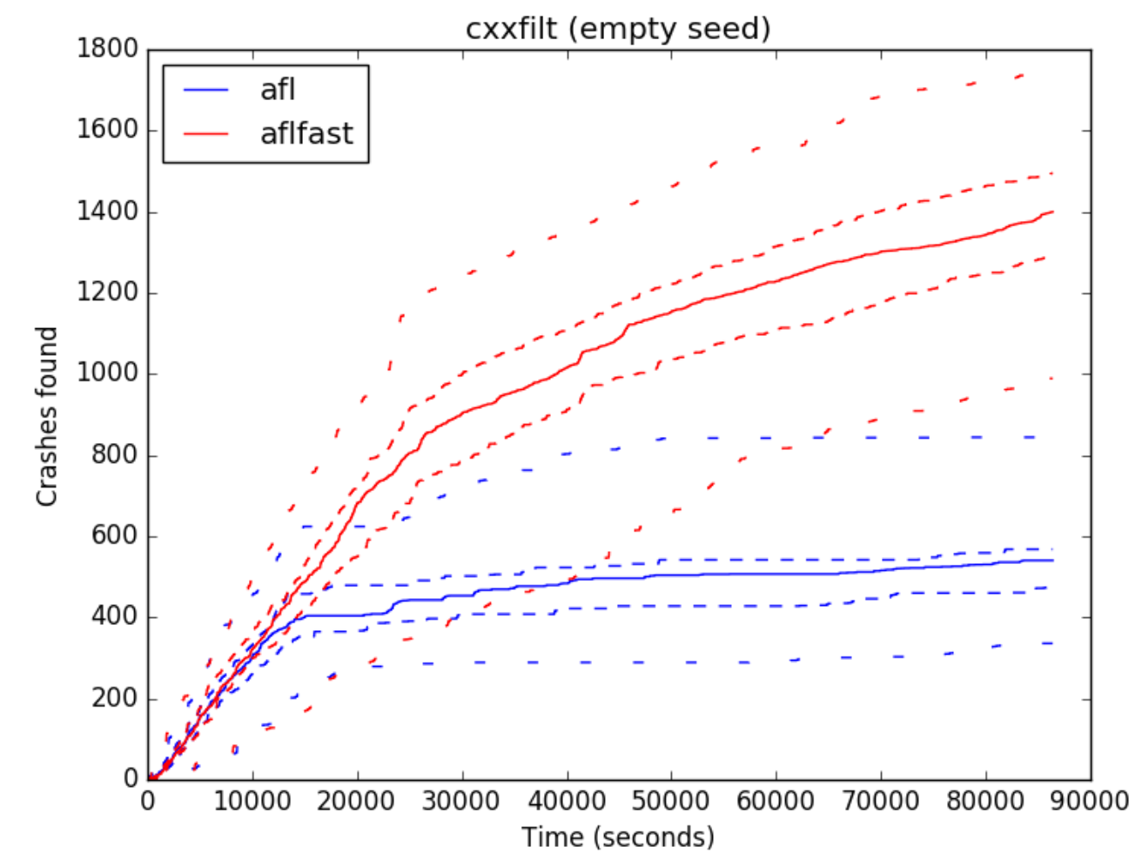
Statistically Significant
p < 10⁻¹³
p < 10⁻¹⁰
significant variance
in performance
Higher median
clearly better

Slide 13
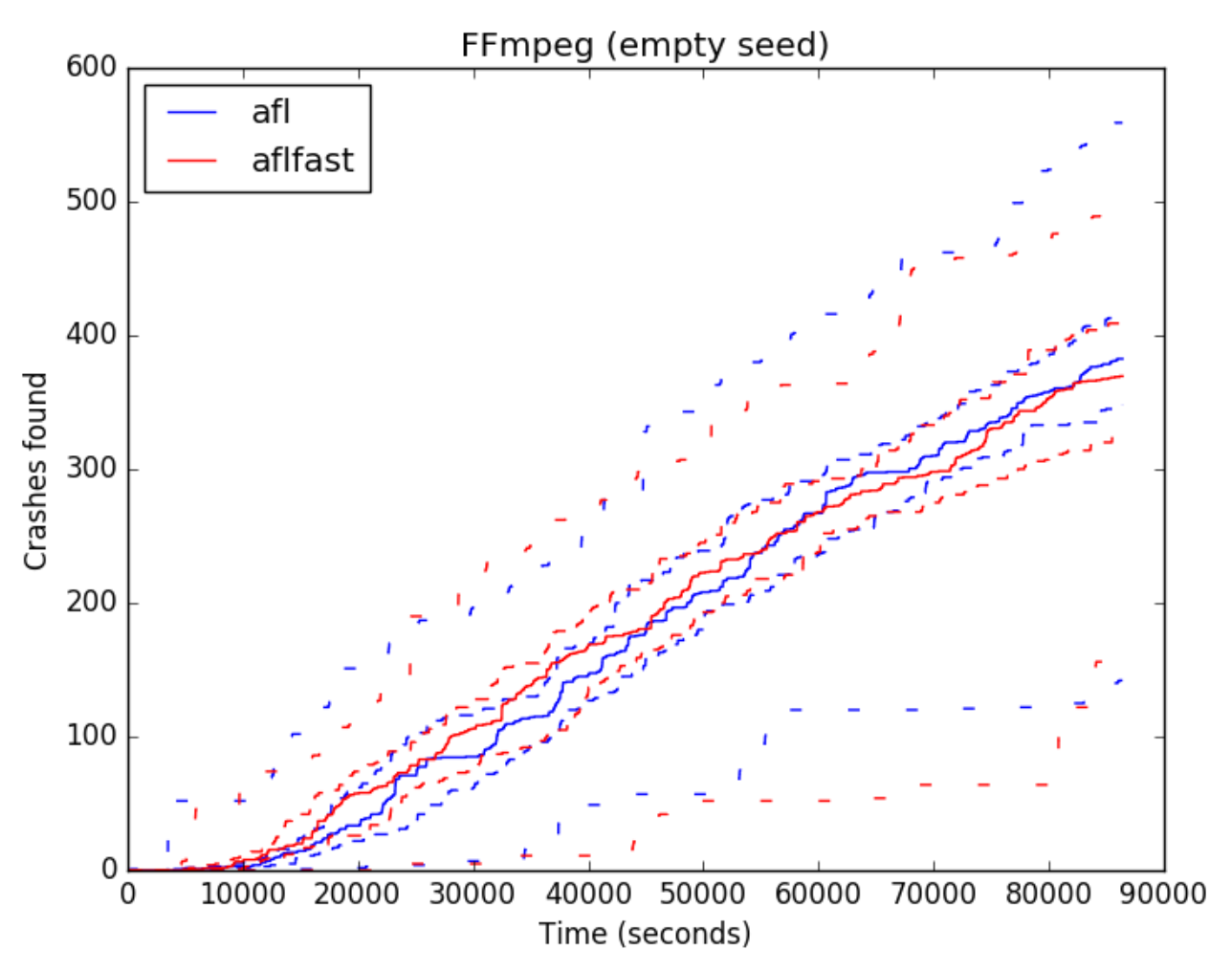
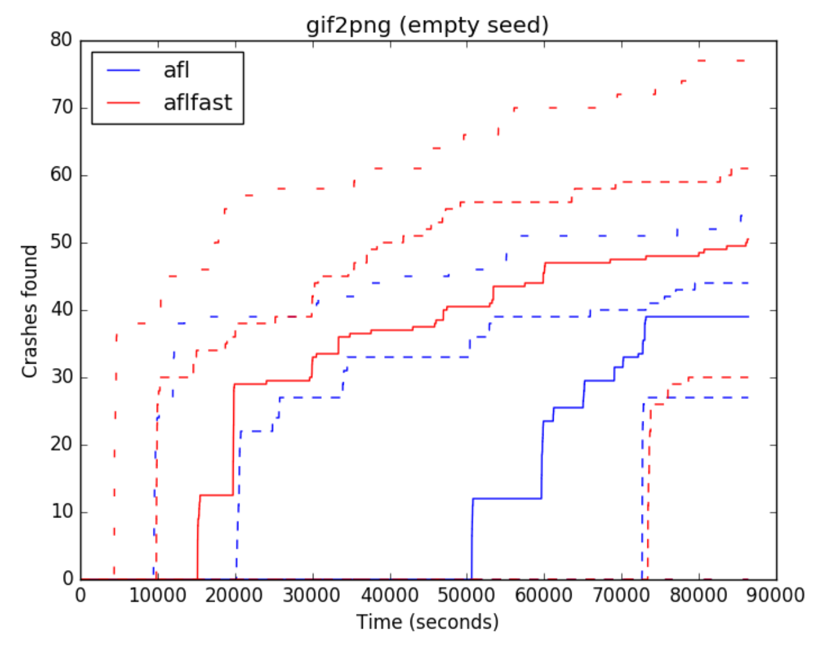
Statistically Insignificant
p = 0.379
p = 0.0676
Higher median
does not meet bar
for significance
Max AFL = 550
Min AFLFast = 150

Slide 14
Summary of Results
Less than 1/2 of 32 papers we looked at did multiple runs
Fewer still consider variance across runs
And yet fuzzer performance can vary substantially from run to run
Papers often choose a small number of target programs, with a small common set
And yet they target the same population
And performance can vary substantially
Few papers justify the choice of seeds or timeouts
Yet seeds strongly influence performance,
And trends can change over time
Many papers use heuristics to relate crashing inputs to bugs
Yet these heuristics have not been evaluated
We find that they dramatically overcount bugs

Slide 15
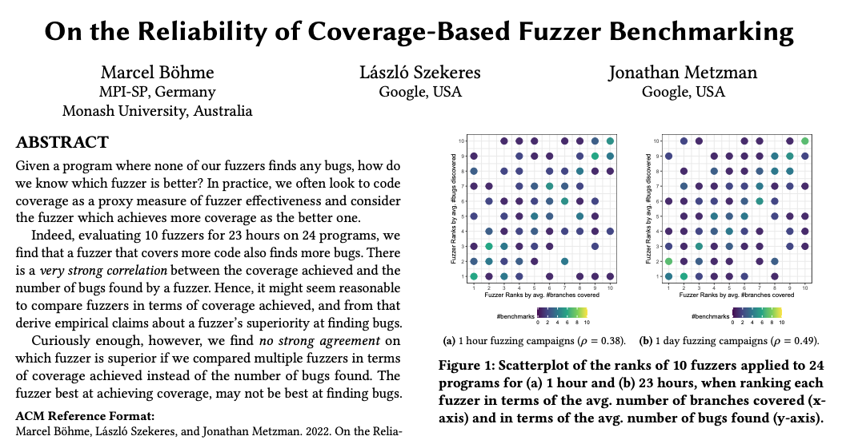
Unreliability of code coverage
Coverage correlates with bug finding
But coverage is no replacement: “More coverage” is not a reliable stand-in for “more bugs found”
2022 paper

Slide 16
(Fuzzy) stack hashes
Idea: Identify bug according to the stack at the time of the crash (return addresses)
Or: Limit attention to the top N frames (where N is between 3 and 5 in most papers)
Rationale: Faulting location highly indicative of source of bug
Stack provides useful context (i.e., when faulting function given a input, only from certain caller)
But some “context” may be superfluous
Assume: frames closer to bug more relevant

Slide 17
False positives and false negatives
void f() { … format(s1); … }
void g() { … format(s2); … }
void format(char *s) {
//bug: corrupt s
prepare(s);
}
void prepare(char *s) {
output(s);
}
void output(char *s) {
//failure manifests
}
With N=3, distinct calls to format from f and g will be conflated, properly
But with N=5, calling format from f and g are made distinct
Overcounting
With N=2, a bug in a different caller to prepare that corrupts its argument will be conflated with the format bug
Undercounting

Slide 18
AFL CMIN
A crashing input is considered “unique” if either
the coverage profile includes an edge (“tuple”) not seen in any of the previous crashes
the profile is missing a tuple always present in earlier faults
AFL calls this CMIN
Docs justify it by mentioning the issues with stack hashes
CMIN may also suffer from inflated counts (false positives)
Many superfluously different paths to the same fault-point are treated as distinct

Slide 19
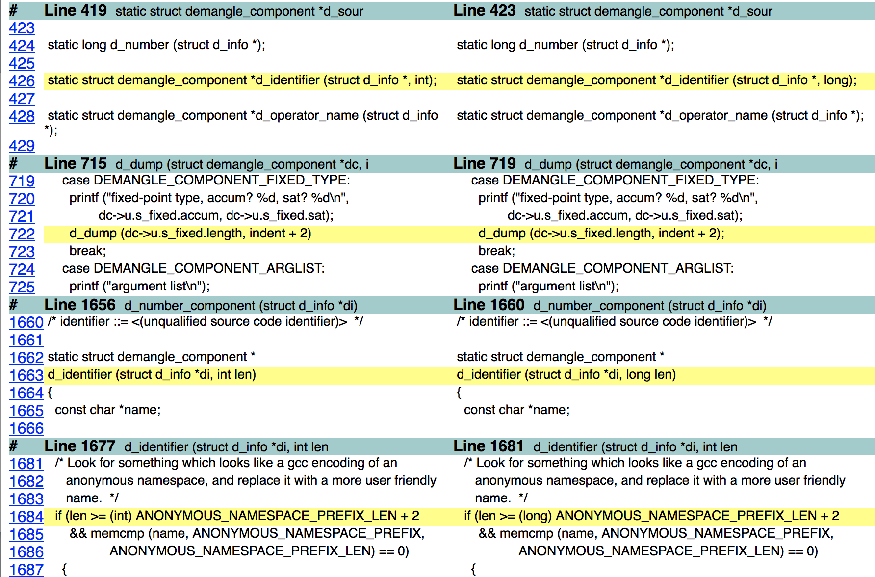
Assessing Heuristics: cxxfilt
Used commit history to find patches since fuzzed version
E.g., commit on left fixes integer overflow
Applied patches iteratively, and re-ran against all 57,000+ crashing inputs (post-CMIN, all 30 runs)
Those that no longer crash are due to this patch
Broke apart patches that fix multiple bugs
Re-run must account for non-determinism
Used ASAN/UBSAN: “non crash” only if it found no issue

Slide 20
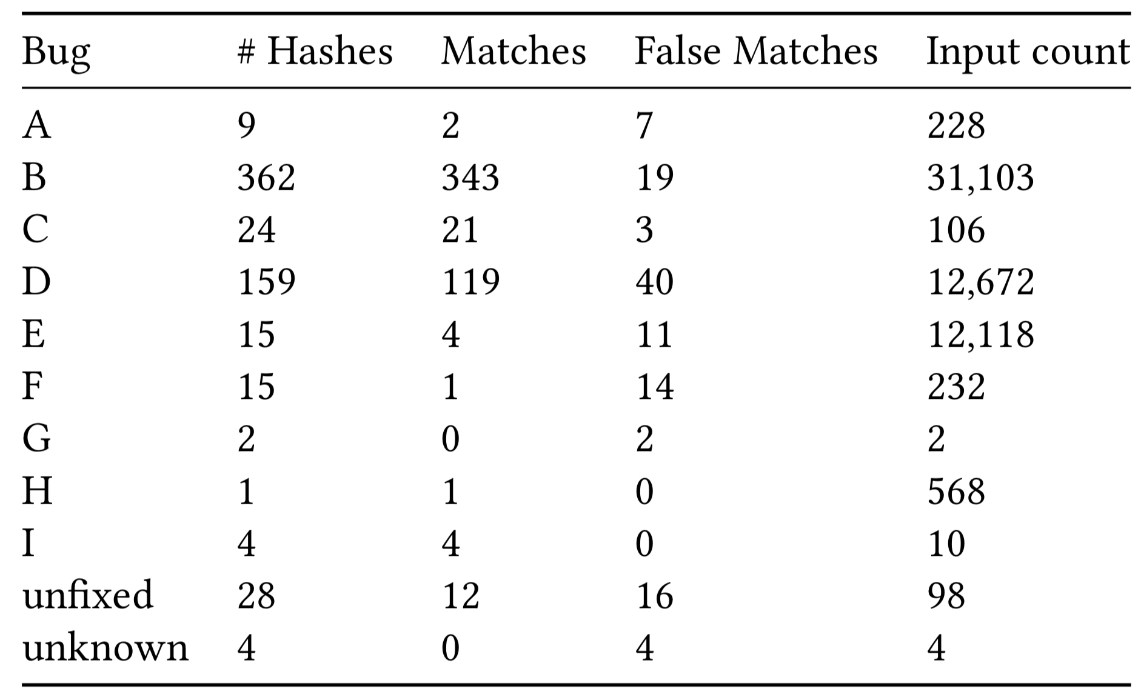
Stack Hashes (N=3)
57,040 inputs handled by bugfix
98 inputs never fixed
4 inputs “fixed” but due to some source of nondeterminism
In general: Far less over counting
At most 596 hashes for 9 bugs
vs. 57,040 inputs for 9 bugs
Hashes have false negatives
Bug B has 343 hashes that apply just to this bug, but 19 that apply to others too

Slide 21
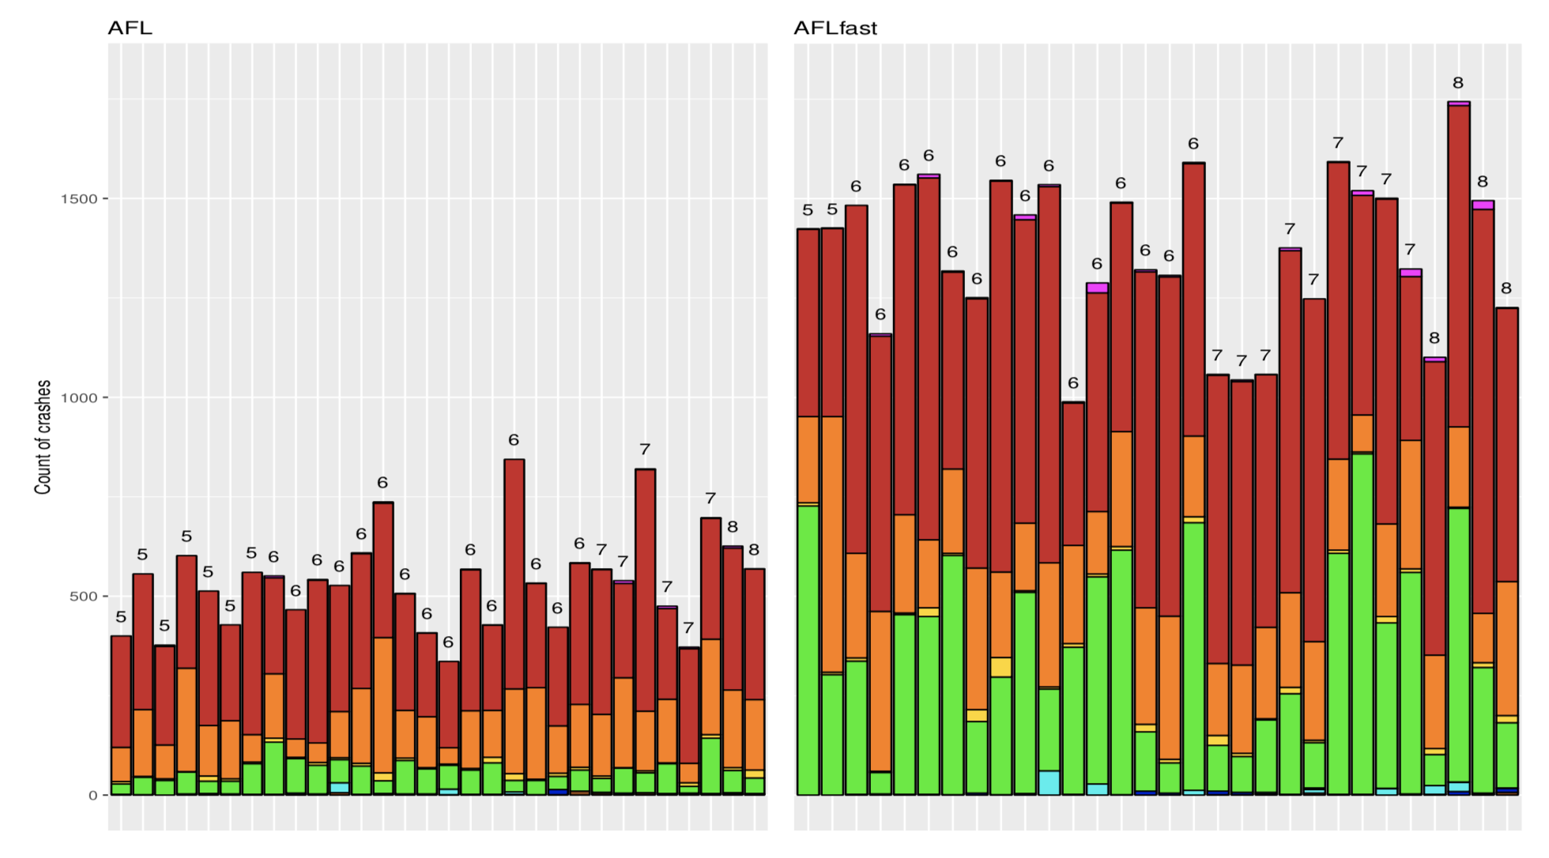
“Unique crashes” (proxy) vs. bugs found
No trial found more than 8 bugs
Out of 9 total
3 bugs account for most crashing inputs
many bugs have few inputs
so counting inputs misleading
Number of crashing inputs correlates with number of bugs, but only loosely
Mann Whitney p-value is .066 for AFLFast bugs > AFL bugs
vs. 10⁻¹⁰ for “unique” crashes

Slide 22
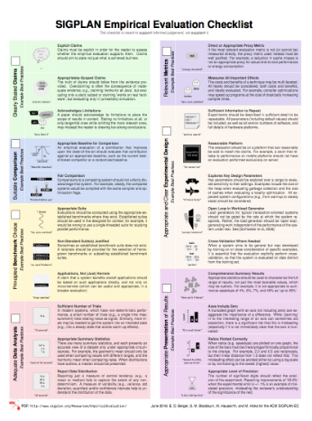

Influence: Empirical evaluation checklist
Researchers should know better. But they forget or are nudged away from best practice by culture and circumstance
Especially when best practice is more effort
Solution: List of recommendations
And identification of open problems
Inspiration for effort to provide checklist broadly
SIGPLAN Empirical Evaluation Guidelines
http://sigplan.org/Resources/EmpiricalEvaluation/

Slide 23
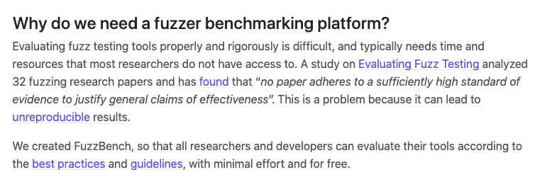
Influence: FuzzBench
https://github.com/google/fuzzbench
Our paper
SIGPLAN Guidelines

Slide 24
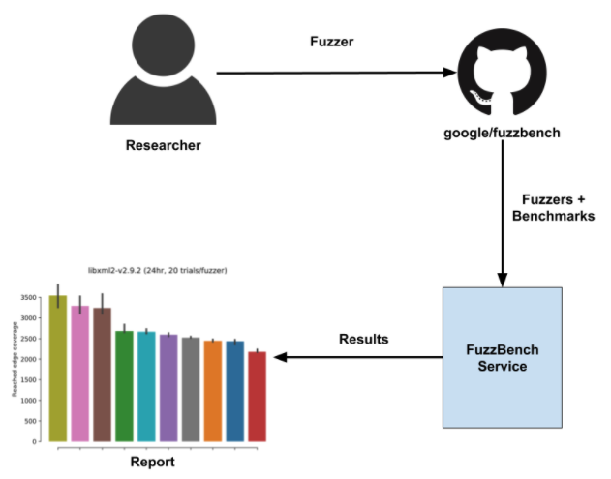
Influence: FuzzBench (coverage driven)
https://github.com/google/fuzzbench

Slide 25

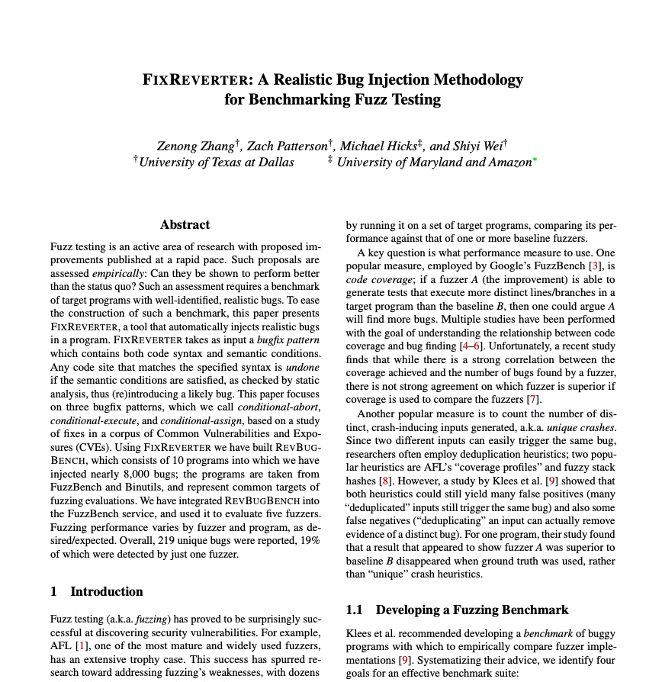
Influence: Bug-driven benchmarks

Slide 26
Discussion points
We’ve discussed incentives many time in this course; how do they apply in this circumstance?
Do any of these results seem to apply to your native field of study?
Are there still understudied areas regarding how to evaluate fuzzers?
I.e., elements that the paper missed?
How should we balance a high bar for evaluation, but not squelch promising ideas?
Fuzzer usage may vary; how should evaluation accommodate that?
What are the pitfalls of standardizing evaluation elements?

Slide 27
Readings

Slide 28
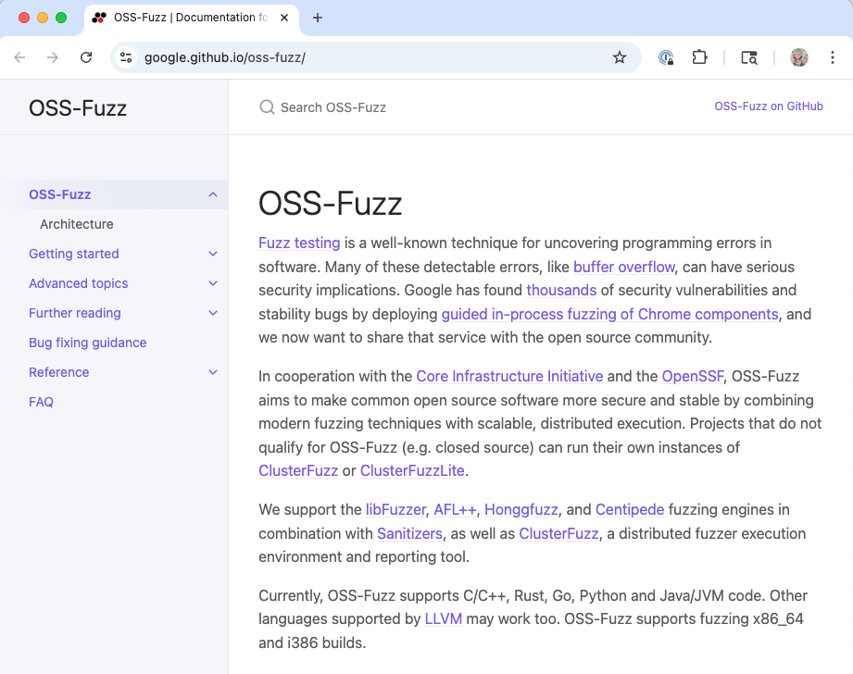
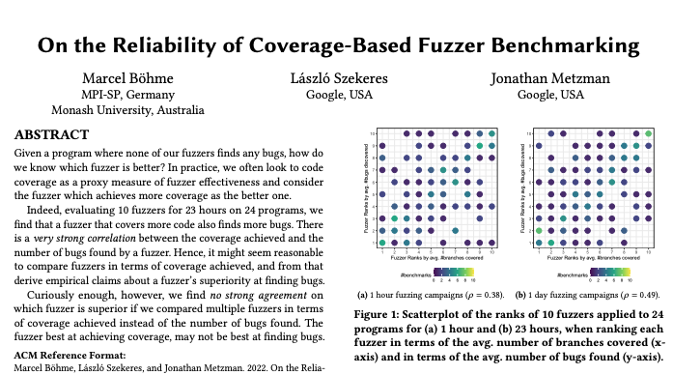
The 6 years since Evaluating Fuzz Testing
280 papers on fuzzing published in top security and SE venues
New benchmarks created (Magma, RevBugBench)
New papers with evaluation guidelines published
Now running on 1200 OSS packages
Are evaluation practices more scientifically sound?

Slide 29
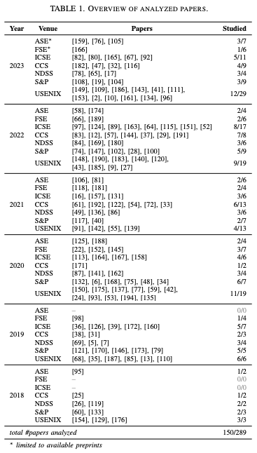
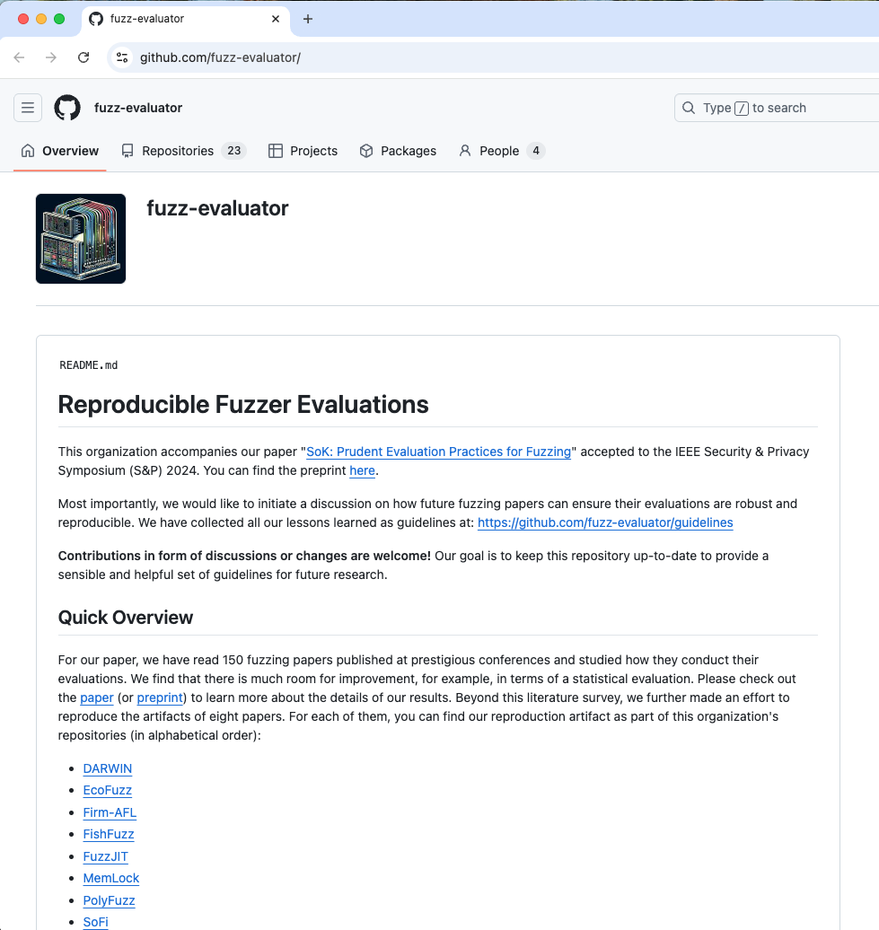
Method of study
Literature review
Artifact re-evaluation

Slide 30
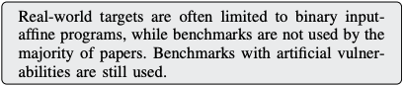
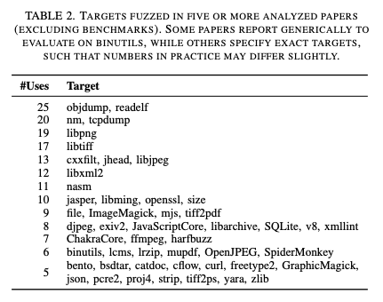
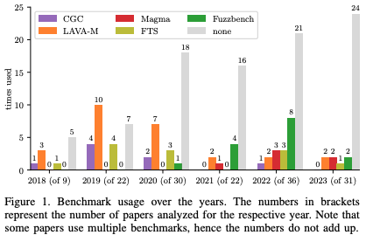
Targets under test

Slide 31
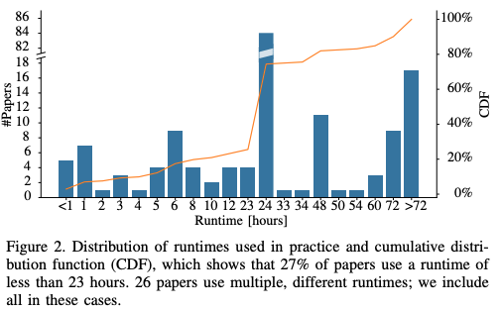
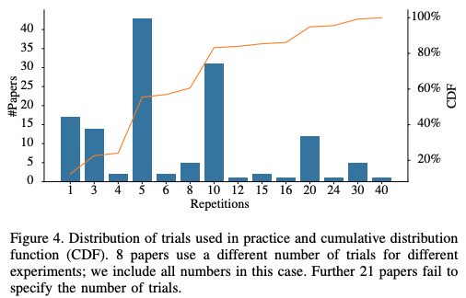
Trial running times, counts
24
5
10
20
Running times
# Trials

Slide 32
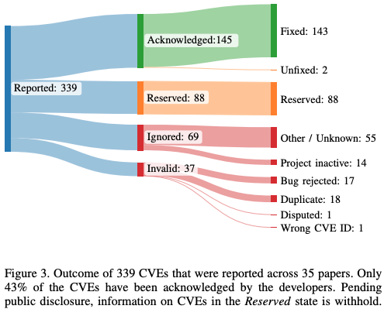
Measure
Code coverage
Beware: many kinds!
Known bugs
“Known bugs are a good way of measuring a fuzzer’s performance, yet it is difficult to find suitable bugs outside well-designed benchmarks, such as Magma [70] or RevBugBench [183].” – so … use those?
Unknown bugs – CVEs

Slide 33
Statistical analysis
63% (94) conduct no statistical test of significance of new fuzzer vs. a baseline’s performance
37% (55) of the papers run a Mann-Whitney U test to measure statistical significance
15% (22) of the analyzed papers conduct a Mann-Whitney U-test while having five or fewer trials. Insufficient # trials risks that it may never reject the hypothesis (captured in higher p value).
73% (109) of the papers provide no measure of uncertainty
12% (18) present a measure like effect size (like A12).

Slide 34
Artifacts evaluated: Reproducibility problems
Statistically sound comparison diminishes published results
Unequal experimental setup between new fuzzer and baseline led to inflated results for new fuzzer
Seems likely unintentional, but also necessary for publication
Lack of standard metrics means new ones lack context
Do the new ones correlate with finding bugs? You can measure that …

Slide 35
Fuzzing Evaluation Recipe (for new fuzzer A)
Revisited
✓
A compelling baseline fuzzer B to compare against
A sample of target programs (benchmark suite)
Representative of larger population
A performance metric
Ideally, the number of bugs found (else a proxy)
A meaningful set of configuration parameters
Notably, justifable seed file(s), timeout
A sufficient number of trials to judge performance
Comparison with baseline using a statistical test
+ensure fair comparison
✓
+prefer standards
✓
+standard code coverage
beware CVEs
✓
✓
or bootstrap tests, ANOVA
+report uncertainty, effect size
✓
And: Publish a reproducible artifact

Slide 36
Discussion points
What different phenomena did this paper find compared to the 2018 paper?
What areas warrant further investigation?
This paper focuses more on reproducibility of artifacts – are there implications for artifact evaluation in review processes
This paper essentially ratified the 2018 paper’s evaluation advice. Given how research has been conducted, do you think further steps should be taken?

